Slide 1

DAPT-2020
Key contributions:
  Capture various aspects of real-world APT
  Atk behaviours both at the interface and inside the net work
  Traffic features encodes several latent characteristics, such as adapatability and stealthiness of APT. first dataset that captures network behaviour spanning across all stages of APT
  Compare with CIC-IDS 2017, 2018 and UNB2015.
  Apply semi-supervised(?) to identify anomalies

Slide 2
DAPT-2020
APT is form of cybersecurity threat posed by well-funded organisation, often to gain crucial information from the target organisation.
5 phases of APT and their corresponding attack vectors:
  Reconnaissance – web app scan, portscan, account discovery
  Foothold Establishment – directory bruteforce, SQL injection, malware download
  Lateral Movement – portscan (on private network), backdoor, SQL injection (pvt)
  Data Exfiltration – exfiltration to a remote FTP servr, google drive upload
  Post Exfiltration
DAPT-2020 covers the first 4 phases.
The data was collection from all network interfaces in the form of pcap files, as well as logs from each host

Slide 3
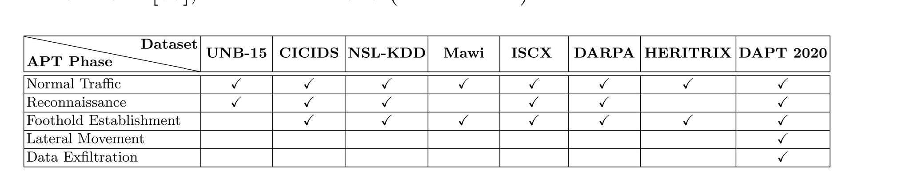
Comparison with others

Slide 4
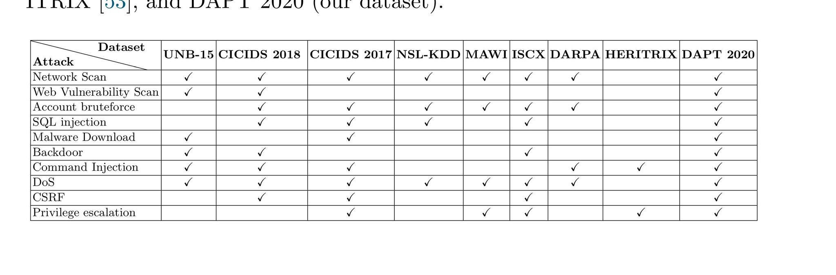
Comparision with others

Slide 5
Evaluation
Semi-supervised learning with
  One class SVM (1-SVM)
  Stacked Auto Encoder (SAE)
  Stacked Auto Encoder with Long Short-term Memory (LSTM-SAE)
Training set contains normal traffic data.
At test time, given an input, pass it through the auto-encoder and check if the normalised reconstruction error is above a certain threshold.

Slide 6
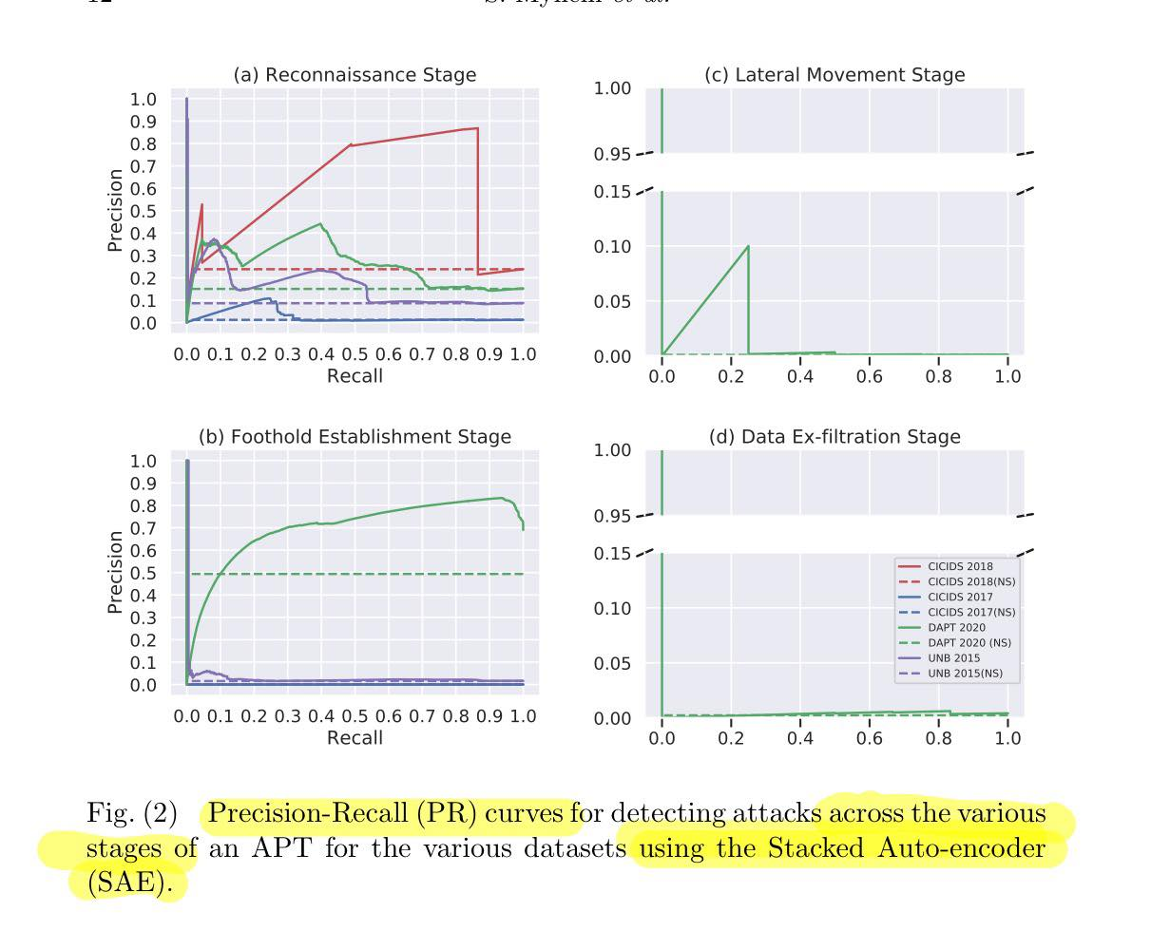
Evaluation

Slide 7
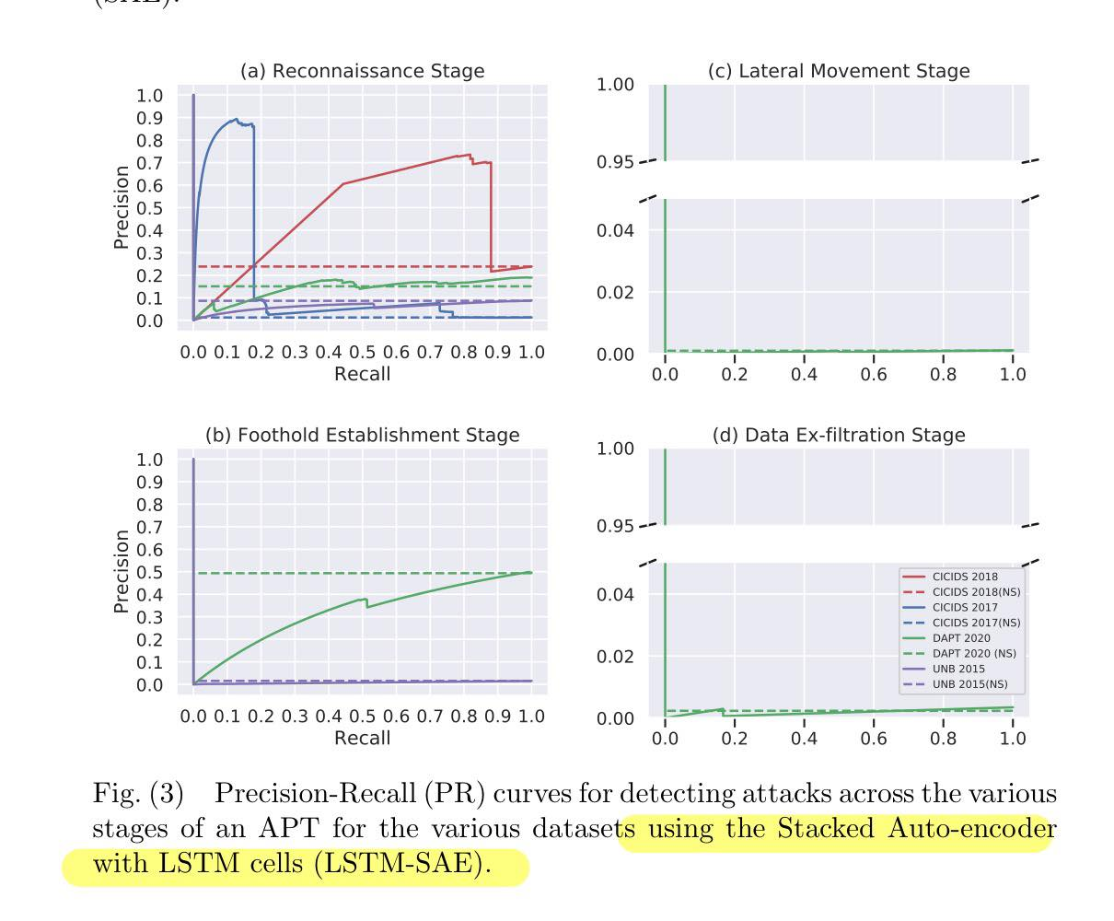
Evaluation

Slide 8
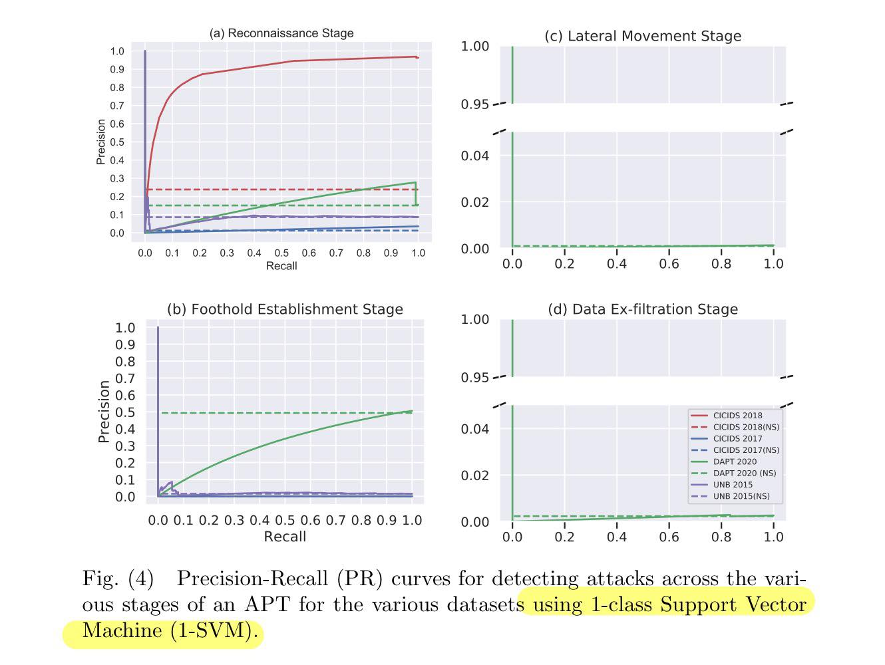
Evaluation

